Slide 1
NAND2Tetris — Project 3
Sequential Logic & Memory Chips
Project 3: Sequential Chips
Bit
Register
RAM8
RAM64
RAM512
RAM4K
RAM16K
PC
Submmited by: Jyoti Sharma
2501420052
Project 3 • NAND2Tetris • Jyoti Sharma 1

Slide 2
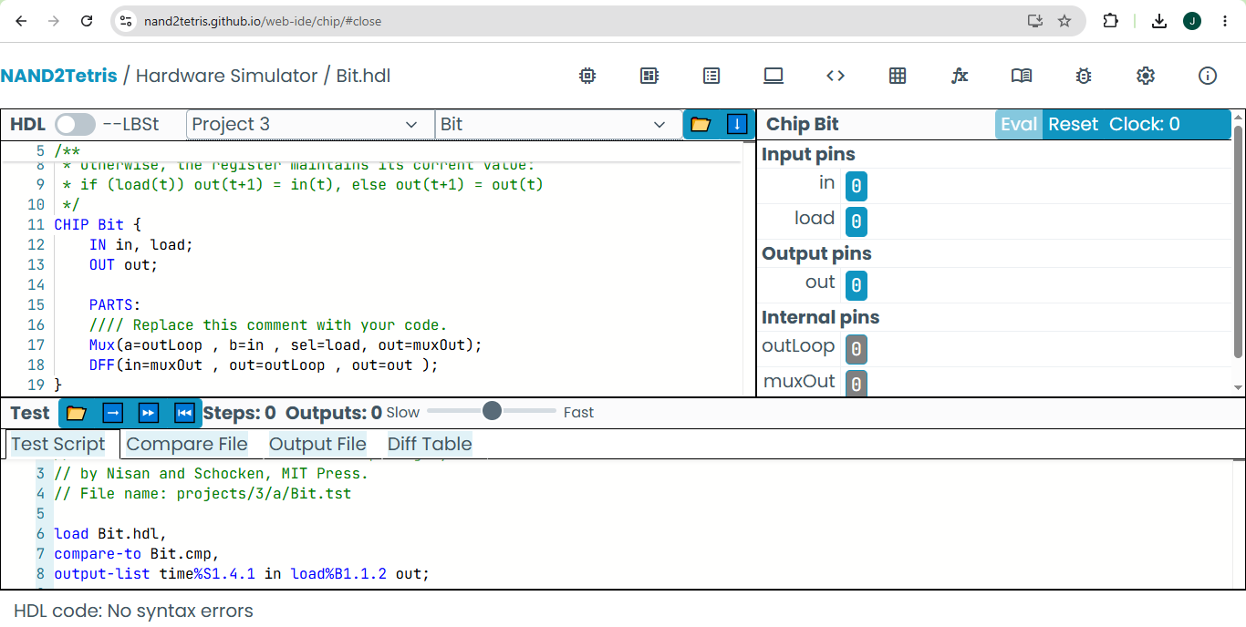
Bit.hdl
NAND2Tetris Hardware Simulator-style code view
Code of BIT
CHIP Bit {
IN in, load;
OUT out;
PARTS:
//// Replace this comment with your code.
Mux(a=outLoop , b=in , sel=load, out=muxOut);
DFF(in=muxOut , out=outLoop , out=out );
}
Project 3 • NAND2Tetris • Jyoti Sharma 2

Slide 3
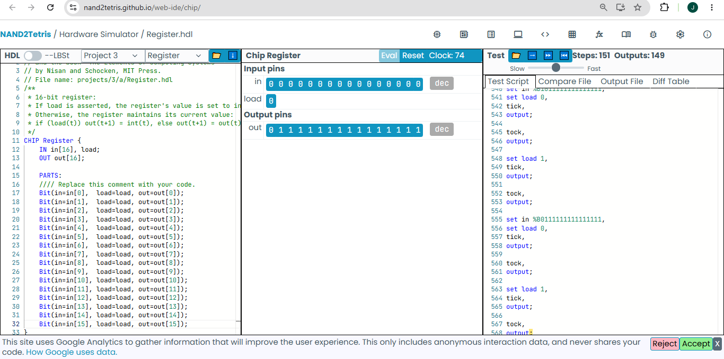
Code of REGISTER
Register.hdl
CHIP Register {
IN in[16], load;
OUT out[16];
PARTS:
//// Replace this comment with your code.
Bit(in=in[0], load=load, out=out[0]);
Bit(in=in[1], load=load, out=out[1]);
Bit(in=in[2], load=load, out=out[2]);
Bit(in=in[3], load=load, out=out[3]);
Bit(in=in[4], load=load, out=out[4]);
Bit(in=in[5], load=load, out=out[5]);
Bit(in=in[6], load=load, out=out[6]);
Bit(in=in[7], load=load, out=out[7]);
Bit(in=in[8], load=load, out=out[8]);
Bit(in=in[9], load=load, out=out[9]);
Bit(in=in[10], load=load, out=out[10]);
Bit(in=in[11], load=load, out=out[11]);
Bit(in=in[12], load=load, out=out[12]);
Bit(in=in[13], load=load, out=out[13]);
Bit(in=in[14], load=load, out=out[14]);
Bit(in=in[15], load=load, out=out[15]);
}
NAND2Tetris Hardware Simulator-style code view
Project 3 • NAND2Tetris • Jyoti Sharma 3

Slide 4
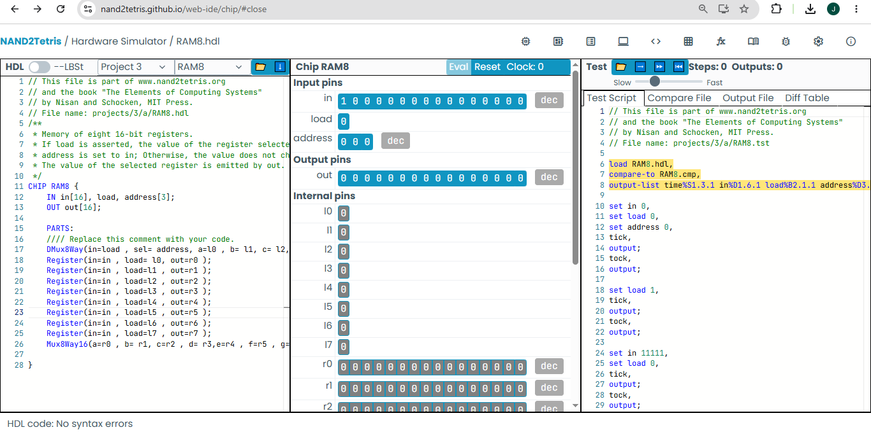
Code of RAM8
RAM8.hdl
NAND2Tetris Hardware Simulator-style code view
CHIP RAM8 {
IN in[16], load, address[3];
OUT out[16];
PARTS:
//// Replace this comment with your code.
DMux8Way(in=load , sel= address, a=l0 , b= l1, c= l2, d=l3 , e=l4 , f=l5 , g=l6 , h=l7 );
Register(in=in , load= l0, out=r0 );
Register(in=in , load=l1 , out=r1 );
Register(in=in , load=l2 , out=r2 );
Register(in=in , load=l3 , out=r3 );
Register(in=in , load=l4 , out=r4 );
Register(in=in , load=l5 , out=r5 );
Register(in=in , load=l6 , out=r6 );
Register(in=in , load=l7 , out=r7 );
Mux8Way16(a=r0 , b= r1, c=r2 , d= r3,e=r4 , f=r5 , g=r6 , h=r7,sel=address, out=out );
}
Project 3 • NAND2Tetris • Jyoti Sharma 4

Slide 5
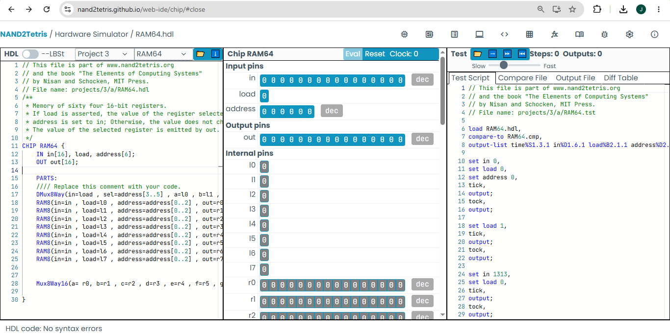
RAM64.hdl
Code of RAM64
NAND2Tetris Hardware Simulator-style code view
CHIP RAM64 {
IN in[16], load, address[6];
OUT out[16];
PARTS:
//// Replace this comment with your code.
DMux8Way(in=load , sel=address[3..5] , a=l0 , b=l1 , c=l2 , d=l3 , e=l4 , f=l5 , g=l6 , h=l7 );
RAM8(in=in , load=l0 , address=address[0..2] , out=r0 );
RAM8(in=in , load=l1 , address=address[0..2] , out=r1 );
RAM8(in=in , load=l2 , address=address[0..2] , out=r2 );
RAM8(in=in , load=l3 , address=address[0..2] , out=r3 );
RAM8(in=in , load=l4 , address=address[0..2] , out=r4 );
RAM8(in=in , load=l5 , address=address[0..2] , out=r5 );
RAM8(in=in , load=l6 , address=address[0..2] , out=r6 );
RAM8(in=in , load=l7 , address=address[0..2] , out=r7 );
Mux8Way16(a= r0, b=r1 , c=r2 , d=r3 , e=r4 , f=r5 , g=r6 , h=r7 , sel=address[3..5] , out=out );
}
Project 3 • NAND2Tetris • Jyoti Sharma 5

Slide 6
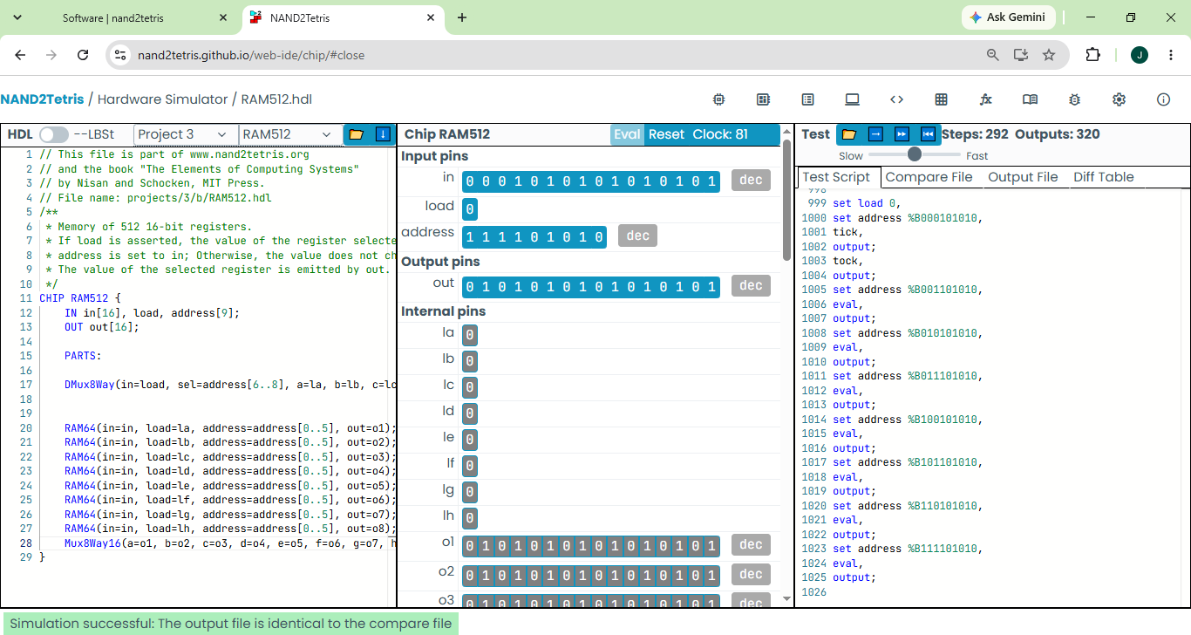
RAM512.hdl
Code of RAM512
CHIP RAM512 {
IN in[16], load, address[9];
OUT out[16];
PARTS:
DMux8Way(in=load, sel=address[6..8], a=la, b=lb, c=lc, d=ld, e=le, f=lf, g=lg, h=lh);
RAM64(in=in, load=la, address=address[0..5], out=o1);
RAM64(in=in, load=lb, address=address[0..5], out=o2);
RAM64(in=in, load=lc, address=address[0..5], out=o3);
RAM64(in=in, load=ld, address=address[0..5], out=o4);
RAM64(in=in, load=le, address=address[0..5], out=o5);
RAM64(in=in, load=lf, address=address[0..5], out=o6);
RAM64(in=in, load=lg, address=address[0..5], out=o7);
RAM64(in=in, load=lh, address=address[0..5], out=o8);
Mux8Way16(a=o1, b=o2, c=o3, d=o4, e=o5, f=o6, g=o7, h=o8, sel=address[6..8], out=out);
}
NAND2Tetris Hardware Simulator-style code view
Project 3 • NAND2Tetris • Jyoti Sharma 6

Slide 7
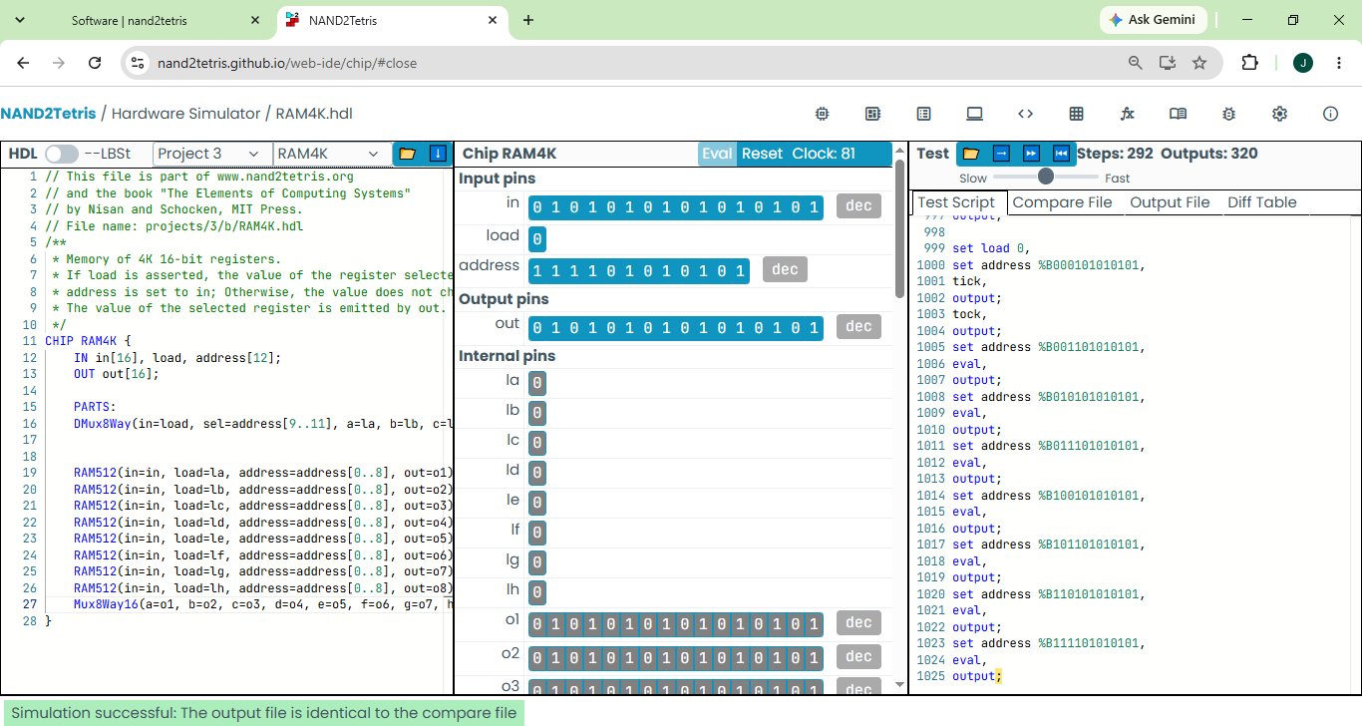
RAM4K.hdl
Code of RAM4K
NAND2Tetris Hardware Simulator-style code view
CHIP RAM4K {
IN in[16], load, address[12];
OUT out[16];
PARTS:
DMux8Way(in=load, sel=address[9..11], a=la, b=lb, c=lc, d=ld, e=le, f=lf, g=lg, h=lh);
RAM512(in=in, load=la, address=address[0..8], out=o1);
RAM512(in=in, load=lb, address=address[0..8], out=o2);
RAM512(in=in, load=lc, address=address[0..8], out=o3);
RAM512(in=in, load=ld, address=address[0..8], out=o4);
RAM512(in=in, load=le, address=address[0..8], out=o5);
RAM512(in=in, load=lf, address=address[0..8], out=o6);
RAM512(in=in, load=lg, address=address[0..8], out=o7);
RAM512(in=in, load=lh, address=address[0..8], out=o8);
Mux8Way16(a=o1, b=o2, c=o3, d=o4, e=o5, f=o6, g=o7, h=o8, sel=address[9..11], out=out);
}
Project 3 • NAND2Tetris • Jyoti Sharma 7

Slide 8
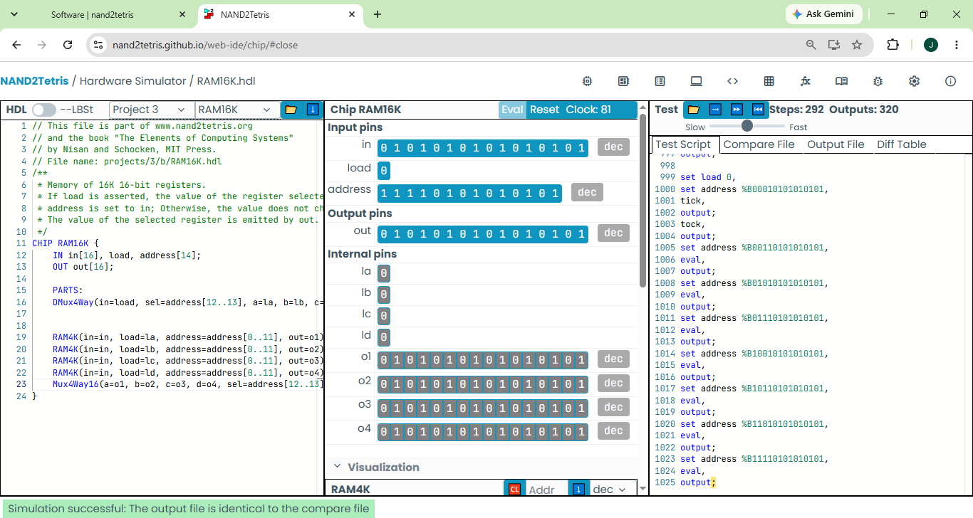
RAM16K.hdl
Code of RAM16K
NAND2Tetris Hardware Simulator-style code view
CHIP RAM16K {
IN in[16], load, address[14];
OUT out[16];
PARTS:
DMux4Way(in=load, sel=address[12..13], a=la, b=lb, c=lc, d=ld);
RAM4K(in=in, load=la, address=address[0..11], out=o1);
RAM4K(in=in, load=lb, address=address[0..11], out=o2);
RAM4K(in=in, load=lc, address=address[0..11], out=o3);
RAM4K(in=in, load=ld, address=address[0..11], out=o4);
Mux4Way16(a=o1, b=o2, c=o3, d=o4, sel=address[12..13], out=out);
}
Project 3 • NAND2Tetris • Jyoti Sharma 8

Slide 9
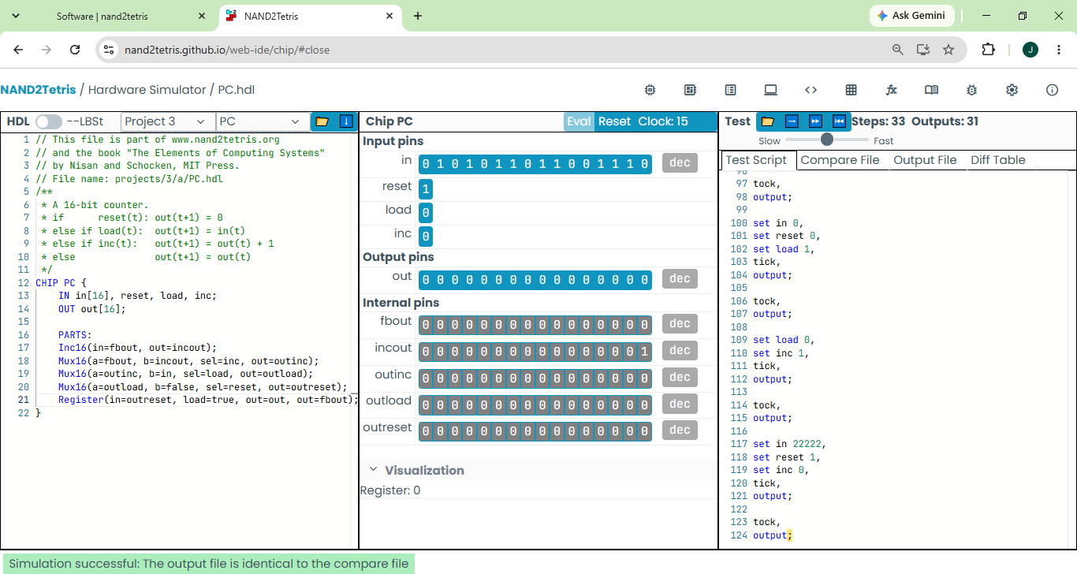
PC.hdl
Code of PC
NAND2Tetris Hardware Simulator-style code view
CHIP PC {
IN in[16], reset, load, inc;
OUT out[16];
PARTS:
Inc16(in=fbout, out=incout);
Mux16(a=fbout, b=incout, sel=inc, out=outinc);
Mux16(a=outinc, b=in, sel=load, out=outload);
Mux16(a=outload, b=false, sel=reset, out=outreset);
Register(in=outreset, load=true, out=out, out=fbout);
}
Project 3 • NAND2Tetris • Jyoti Sharma 9

Slide 10
Project 3 Summary
All main sequential chips and memory hierarchy
Bit — 1-bit storage
Register — 16-bit storage
RAM8 — 8 × 16-bit
RAM64 — 64 × 16-bit
RAM512 — 512 × 16-bit
RAM4K — 4K × 16-bit
RAM16K — 16K × 16-bit
PC — Program Counter
Each HDL file can be opened and tested with its matching .tst file in the Hardware Simulator.
Project 3 • NAND2Tetris • Jyoti Sharma 11

